Slide 1
PRINCIPLES OF COMMUNICATION AND COMPUTER NETWORKS

Slide 2
Outline
Data Communication
Data Flow
Network Criteria
Type of Network Connection
Network Topologies or Physical Topology
Types of Networks

Slide 3
Data Communication
A data communications system has five components
Message
Sender
Receiver
Medium
Protocol

Slide 4
Data Flow
Communication between two devices can be simplex, half-duplex, or full-duplex as shown in Figure.

Slide 5
Network Criteria
A network must be able to meet a certain number of criteria. The most important of these are Performance, Reliability, and Security.
Performance
Performance can be measured in many ways, including transit time and response time.
The performance of a network depends on a number of factors, including the number of users, the type of transmission medium
Performance is often evaluated by two networking metrics: throughput and delay.
Reliability
In addition to accuracy of delivery, network reliability is measured by the frequency of failure, the time it takes a link to recover from a failure

Slide 6
Network Criteria
Security
Network security issues include protecting data from unauthorized access, protecting data from damage and development, and implementing policies and procedures for recovery from breaches and data losses

Slide 7
Type of Network Connection
A network is two or more devices connected through links. A link is a communications pathway that transfers data from one device to another.
There are two possible types of connections: point-to-point and multipoint

Slide 8
Unit 1 part a: network hardware

Slide 9
content
Network Hardware
Network Topologies
Network Categories
Network Software
Reference Models
OSI (Open System Interconnect)
TCP/IP
Example Networks
ARPANET
INTERNET

Slide 10
Network Topologies or Physical Topology
The term physical topology refers to the way in which a network is laid out physically.
Two or more devices connect to a link; two or more links form a topology.
The topology of a network is the geometric representation of the relationship of all the links and linking devices (usually called nodes) to one another.
There are four basic topologies possible: mesh, star, bus, and ring

Slide 11
Mesh topology
A mesh topology is the one where every node is connected to every other node in the network.
A mesh topology can be a full mesh topology or a partially connected mesh topology.
The number of connections in this network can be calculated using the following formula (n is the number of computers in the network): n(n-1)/2

Slide 12
Mesh topology
Advantages of a mesh topology
Can handle high amounts of traffic, because multiple devices can transmit data simultaneously.
A failure of one device does not cause a break in the network or transmission of data.
Adding additional devices does not disrupt data transmission between other devices.
Disadvantages of a mesh topology
The cost to implement is higher than other network topologies, making it a less desirable option.
Building and maintaining the topology is difficult and time consuming.
The chance of redundant connections is high, which adds to the high costs and potential for reduced efficiency.

Slide 13
star topology
A star network, star topology is one of the most common network setups.
In this configuration, every node connects to a central network device, like a hub, switch, or computer.
The central network device acts as a server and the peripheral devices act as clients.
Depending on the type of network card used in each computer of the star topology, a coaxial cable or a RJ-45 network cable is used to connect computers together.

Slide 14
Star topology
Advantages of star topology
Centralized management of the network, through the use of the central computer, hub, or switch.
Easy to add another computer to the network.
If one computer on the network fails, the rest of the network continues to function normally.
The star topology is used in local-area networks (LANs), High-speed LANs often use a star topology with a central hub.
Disadvantages of star topology
Can have a higher cost to implement, especially when using a switch or router as the central network device.
The central network device determines the performance and number of nodes the network can handle.
If the central computer, hub, or switch fails, the entire network goes down and all computers are disconnected from the network

Slide 15
BUS Topology
A bus topology or a line topology is a network setup in which each computer and network device are connected to a single cable or backbone.
Advantages of bus topology
It works well when you have a small network.
It's the easiest network topology for connecting computers or peripherals in a linear fashion.
It requires less cable length than a star topology.
Disadvantages of bus topology
It can be difficult to identify the problems if the whole network goes down.
It can be hard to troubleshoot individual device issues.
Bus topology is not great for large networks.
Terminators are required for both ends of the main cable.
Additional devices slow the network down.
If a main cable is damaged, the network fails or splits into two.

Slide 16
ring topology
A ring topology is a network configuration in which device connections create a circular data path.
In a ring network, packets of data travel from one device to the next until they reach their destination.
Most ring topologies allow packets to travel only in one direction, called a unidirectional ring network.

Slide 17
Ring topology
Advantages of ring topology
All data flows in one direction, reducing the chance of packet collisions.
A network server is not needed to control network connectivity between each workstation.
Data can transfer between workstations at high speeds.
Additional workstations can be added without impacting performance of the network.
Disadvantages of ring topology
All data being transferred over the network must pass through each workstation on the network, which can make it slower than a star topology.
The entire network will be impacted if one workstation shuts down.
The hardware needed to connect each workstation to the network is more expensive than Ethernet cards and hubs/switches.

Slide 18
Hybrid Topology
A network can be hybrid. For example, we can have a main star topology with each branch connecting several stations in a bus topology as shown in Figure

Slide 19
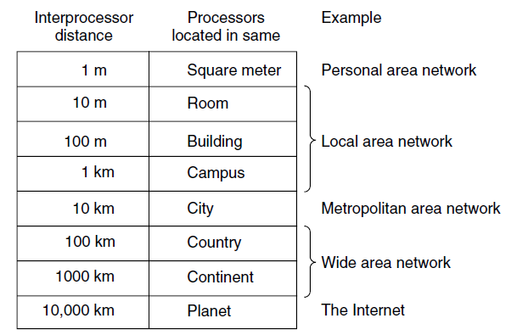
Network categories or types
The types of network are classified based upon the size, the area it covers and its physical architecture.
The five primary network categories are
PAN (Personal Area Network)
LAN (Local Area Network)
MAN (Metropolitan Area Network)
WAN (Wide Area Network)
Internetworks

Slide 20
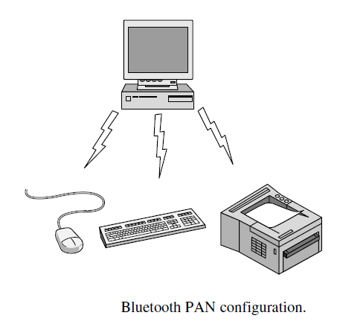
Personal area networks (PAN)
PANs (Personal Area Networks) let devices communicate over the range of a person.
A common example is a wireless network that connects a computer with its peripherals.
Figure show a short-range wireless network called Bluetooth to connect these components without wires.

Slide 21
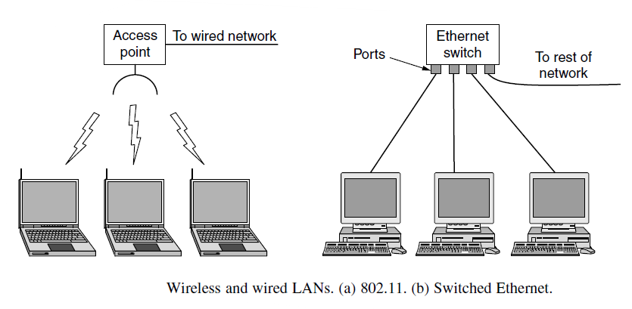
Local area network
A LAN is a privately owned network that operates within and nearby a single building like a home, office or factory.
LANs are widely used to connect personal computers and consumer electronics to let them share resources (e.g., printers) and exchange information.
Wireless LANs are very popular these days, especially in homes, older office buildings, cafeterias, and other places where it is too much trouble to install cables.
There is a standard for wireless LANs called IEEE 802.11, popularly known as WiFi, which has become very widespread.

Slide 22
Local area network
WLAN runs at speeds anywhere from 1 to 100 Mbps
Typically, wired LANs run at speeds of 100 Mbps to 1 Gbps, have low delay (microseconds or nanoseconds), and make very few errors.
Compared to wireless networks, wired LANs exceed them in all dimensions of performance. It is just easier to send signals over a wire or through a fiber than through the air.

Slide 23
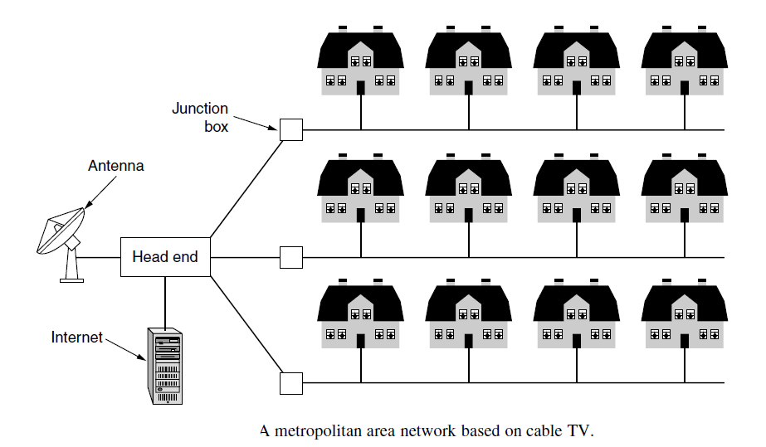
Metropolitan Area Networks
A MAN (Metropolitan Area Network) covers a city.
The best-known examples of MANs are the cable television networks available in many cities or Organization with different branches located in the city.
Recent developments in highspeed wireless Internet access have resulted in another MAN, which has been standardized as IEEE 802.16 and is popularly known as WiMAX
Notes:
WiMax stands for Worldwide Inter-operability for Microwave Access. This technology is based on IEEE 802.16. It is used to provide higher data rates with increased coverage. It is based on MAN (Metropolitan Area Network) technology. Its range is upto 50 Km.

Slide 24
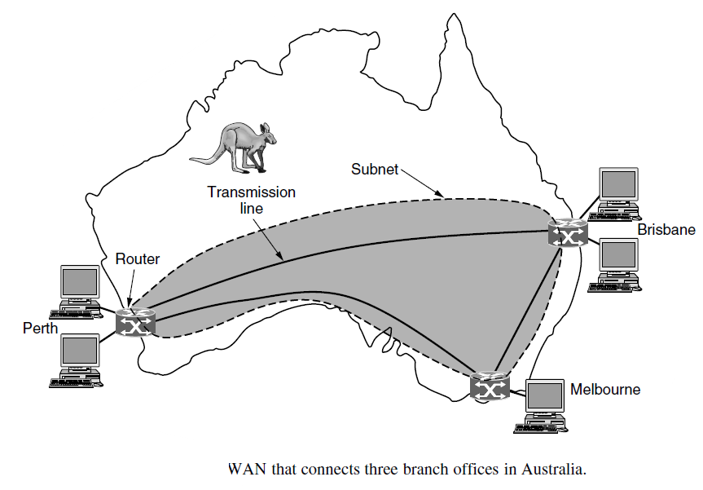
Wide Area Networks
A WAN (Wide Area Network) spans a large geographical area, often a country or continent.

Slide 25
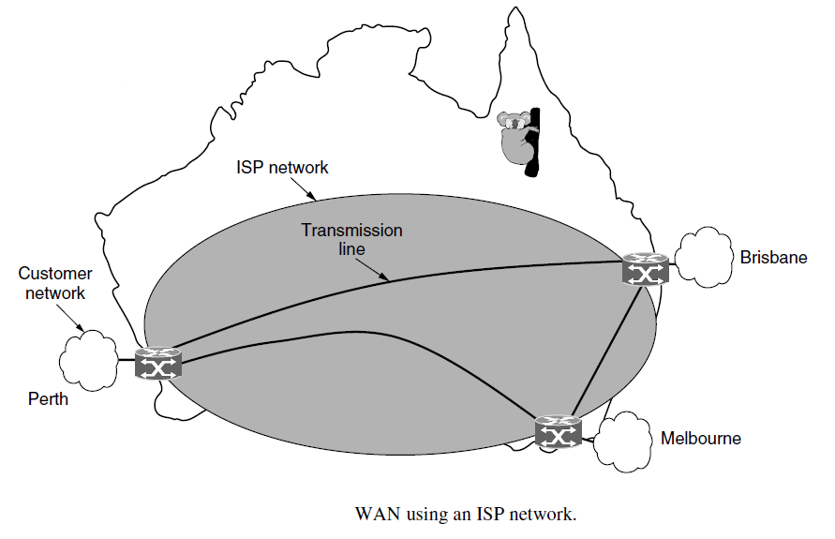
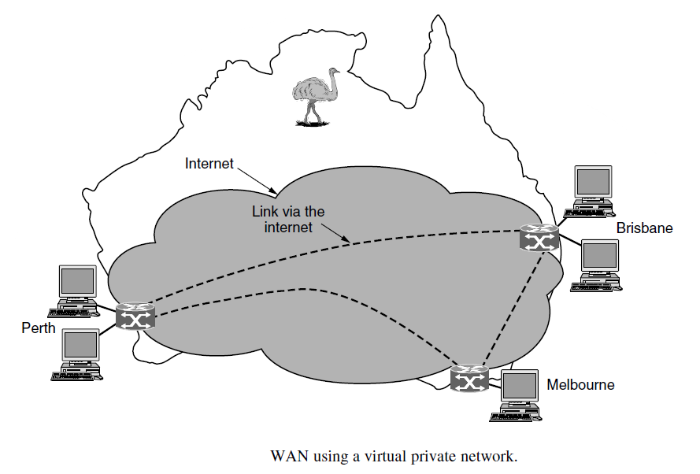
Wide Area Networks

Slide 26
Internetworks
Many networks exist in the world, often with different hardware and software.
People connected to one network often want to communicate with people attached to a different one.
The fulfillment of this desire requires that different, and frequently incompatible, networks be connected.
A collection of interconnected networks is called an internetwork or internet.

Slide 27
Network software
The first computer networks were designed with the hardware as the main concern and the software as an afterthought.
Network software is now highly structured
Protocol Hierarchies
To reduce their design complexity, most networks are organized as a stack of layers or levels, each one built upon the one below it.
The number of layers, the name of each layer, the contents of each layer, and the function of each layer differ from network to network
Each layer is a kind of virtual machine, offering certain services to the layer above it.

Slide 28
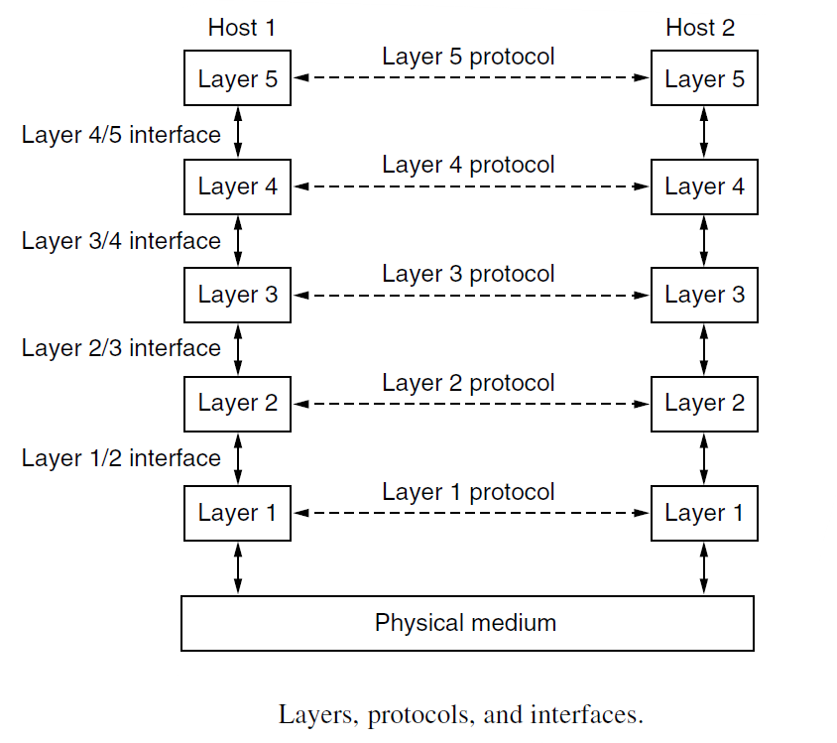
Protocol Hierarchies
When layer n on one machine carries on a conversation with layer n on another machine, the rules and conventions used in this conversation are collectively known as the layer n protocol
A protocol is an agreement between the communicating parties on how communication is to proceed.
The entities comprising the corresponding layers on different machines are called peers.
The peers may be software processes, hardware devices, or even human beings
In other words, it is the peers that communicate by using the protocol to talk to each other.

Slide 29
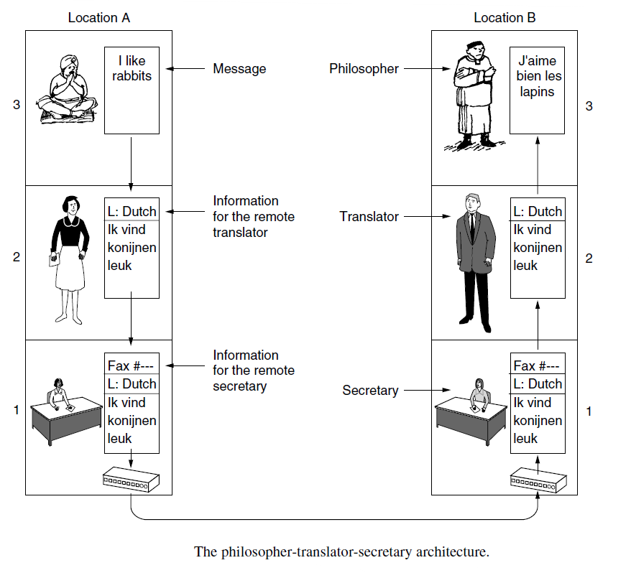
Protocol Hierarchies
A set of layers and protocols is called a network architecture
A list of the protocols used by a certain system, one protocol per layer, is called a protocol stack
The idea of multilayer communication as illustrated in Fig. beside

Slide 30
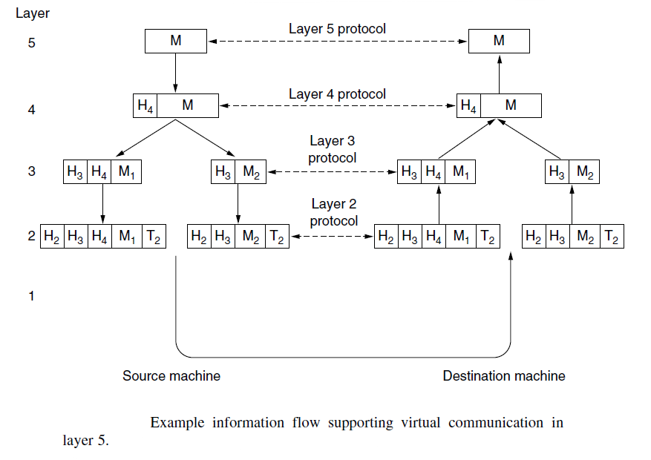
Protocol Hierarchies

Slide 31
Design Issues for the Layers
Reliability is the design issue of making a network that operates correctly even though it is made up of a collection of components that are themselves unreliable
1. Reliability Issues
Error detection and Error correction
Routing
2. Evolution of the network
Protocol layering
Addressing or Naming
Internet working
Scalable

Slide 32
Design Issues for the Layers
3. Resource Allocation
Statistical multiplexing
Flow control
Congestion
Real-Time
Quality of service
4. Security
Secure the network by defending it against different kinds of threats
Confidentiality
Authentication
Integrity

Slide 33
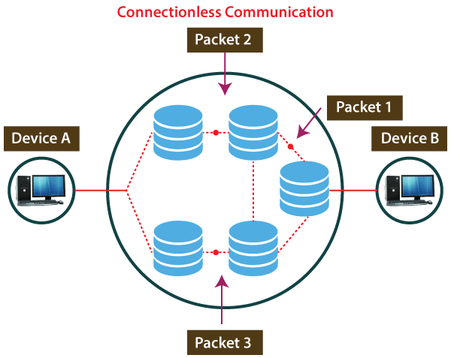
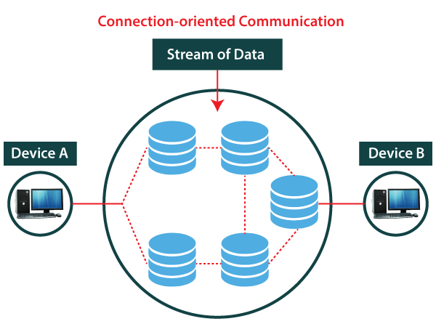
Connection-Oriented Versus Connectionless Service
Layers can offer two different types of service to the layers above them: connection-oriented and connectionless
Connection-oriented service involves the creation and termination of the connection for sending the data between two or more devices
Connectionless service does not require establishing any connection and termination process for transferring the data over a network

Slide 34
Connection-Oriented Versus Connectionless Service
S. No | Comparison Parameters | Connection Oriented | Connection Less
1 | Related System | Telephone | Postal
2 | Virtual Path | Yes | No
3 | Authentication | Yes | No
4 | Data Packets Path | Same order | Randomly
5 | Bandwidth Requirement | High | Low
6 | Data Reliability | Reliable | Not reliable
7 | Congestion | No | Yes
8 | Examples | Transmission Control Protocol (TCP) | User Datagram Protocol (UDP), Internet Protocol (IP), and Internet Control Message Protocol (ICMP)

Slide 35
Service Primitives
Service generally includes set of various primitives
A primitive simply means Operations
Types of Service Primitives
Generally service primitives are divided into four classes −
Request − A service node wants some service from its adjacent layer to pass the parameters to mention the requested service.
Indication − Another Service node or receiver node gets an indication that a procedure has been invoked by the adjacent service node.
Response − A receiver service node acknowledges or completes some procedure.
Confirm − service nodes acknowledge the permission to get connected or not.

Slide 36
Service Primitives
Connection Oriented Service
The service primitives for the connection-oriented services are as follows −
CONNECT. request: Request a connection to be established.
CONNECT. indication: Signal the called party (phone ringing).
CONNECT. response: Accept / reject calls.
CONNECT. confirm: Tell the caller whether the call was accepted.
DATA. request: Request that data be sent.
DATA. indication: Signal the arrival of data.
DISCONNECT. request: Request that a connection be released.
DISCONNECT. indication: Signal the peer about the request.
Example: Modern Telephone and Internet Services
Connection less Service
The service primitives for the connection less services are as follows −
SENDING. data − Sender just sending data (traditional postal service).
REPORT. confirm − availability of reports the data reached at destination (registered post)
Primitive | Explanation
Indication | Information given by an node of an event Example − The receiver just received a connection request.
Request | Service is requested by the node. Example − Requesting for a connection to a remote computer.
Response | Node is responding to an event. Example − the receiver sending the permission to connect.
Confirm | A node acknowledges the response to its request. Example − receiver acknowledge after receiving the data from sender

Slide 37
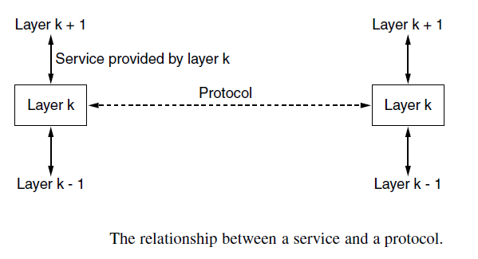
The Relationship of Services to Protocols
A service is a set of primitives (operations) that a layer provides to the layer above it.
Service relates to an interface between two layers, with the lower layer being the service provider and the upper layer being the service user.
A protocol, in contrast, is a set of rules governing the format and meaning of the packets, or messages that are exchanged by the peer entities within a layer.
Entities use protocols to implement their service definitions

Slide 38
REFERENCE MODELS
There are two important network architectures:
The OSI reference model and
The TCP/IP reference model
Although the protocols associated with the OSI model are not used any more, the model itself is actually quite general and still valid, and the features discussed at each layer are still very important.
The TCP/IP model has the opposite properties: the model itself is not of much use but the protocols are widely used.

Slide 39
The OSI Reference Model
OSI stands for Open System Interconnection is a reference model that describes how information from a software application in one computer moves through a physical medium to the software application in another computer.
OSI model was developed by the International Organization for Standardization (ISO) in 1984, and it is now considered as an architectural model for the inter-computer communications.
OSI consists of seven layers, and each layer performs a particular network function
OSI model divides the whole task into seven smaller and manageable tasks. Each layer is assigned a particular task.
Each layer is self-contained, so that task assigned to each layer can be performed independently.

Slide 40
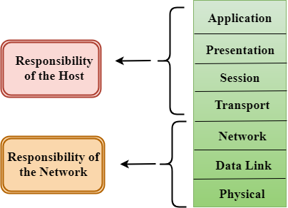
OSI Reference Model
Characteristics of OSI Model:
The OSI model is divided into two layers: upper layers and lower layers.
The upper layer of the OSI model mainly deals with the application related issues, and they are implemented only in the software.
The lower layer of the OSI model deals with the data transport issues. The data link layer and the physical layer are implemented in hardware and software.

Slide 41
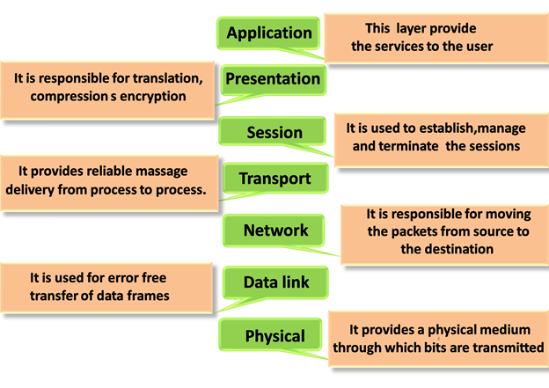
Functions of the OSI Layers
There are the seven OSI layers. Each layer has different functions.
A list of seven layers are given below:
Physical Layer
Data-Link Layer
Network Layer
Transport Layer
Session Layer
Presentation Layer
Application Layer
Notes:
Please Do Not Throw Sausage Pizza Away

Slide 42
Physical layer
Functions of a Physical layer
Line Configuration: It defines the way how two or more devices can be connected physically.
Data Transmission: It defines the transmission mode whether it is simplex, half-duplex or full-duplex mode between the two devices on the network.
Topology: It defines the way how network devices are arranged.
Signals: It determines the type of the signal used for transmitting the information

Slide 43
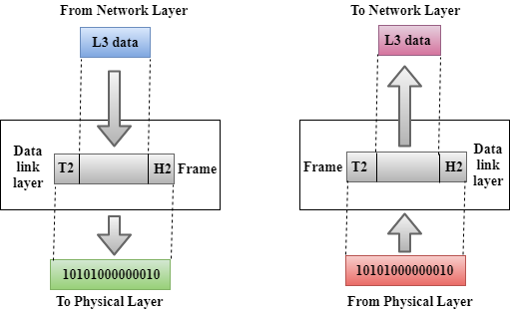
Data-Link Layer
This layer is responsible for the error-free transfer of data frames.
It defines the format of the data on the network.
It provides a reliable and efficient communication between two or more devices.
It contains two sub-layers:
1. Logical Link Control Layer
2. Media Access Control Layer

Slide 44

Functions of the Data-link layer
Framing
Physical Addressing
Flow Control
Error Control
Access Control

Slide 45
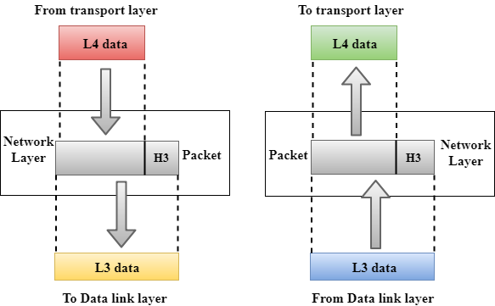
Network Layer
It is a layer 3 that manages device addressing, tracks the location of devices on the network.
It determines the best path to move data from source to the destination based on the network conditions, the priority of service, and other factors.
The Data link layer is responsible for routing and forwarding the packets.
Routers are the layer 3 devices, they are specified in this layer and used to provide the routing services within an internetwork.
The protocols used to route the network traffic are known as Network layer protocols. Examples of protocols are IPv4 and IPv6.

Slide 46
Functions of Network Layer
Internetworking: An internetworking is the main responsibility of the network layer. It provides a logical connection between different devices.
Addressing: A Network layer adds the source and destination address to the header of the frame. Addressing is used to identify the device on the internet.
Routing: Routing is the major component of the network layer, and it determines the best optimal path out of the multiple paths from source to the destination.
Packetizing: A Network Layer receives the packets from the upper layer and converts them into packets. This process is known as Packetizing. It is achieved by internet protocol (IP).

Slide 47
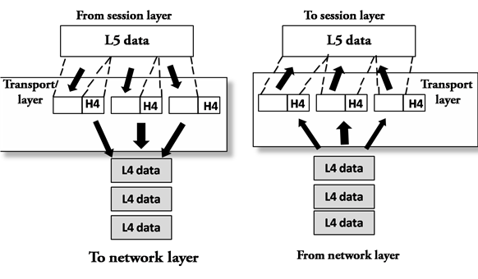
Transport Layer
The Transport layer is a Layer 4 ensures that messages are transmitted in the order in which they are sent and there is no duplication of data.
The main responsibility of the transport layer is to transfer the data completely.
It receives the data from the upper layer and converts them into smaller units known as segments.
This layer can be termed as an end-to-end layer as it provides a point-to-point connection between source and destination to deliver the data reliably.
The two protocols used in this layer are TCP and UDP

Slide 48
Functions of Transport Layer
Service-point addressing
Segmentation and reassembly
Connection control
Flow control
Error control

Slide 49
Session Layer
It is a layer 3 in the OSI model.
The Session layer is used to establish, maintain and synchronizes the interaction between communicating devices.
Functions of Session layer
Dialog control
Synchronization

Slide 50
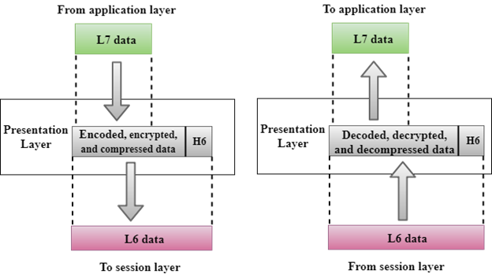
Presentation Layer
A Presentation layer is mainly concerned with the syntax and semantics of the information exchanged between the two systems.
It acts as a data translator for a network.
This layer is a part of the operating system that converts the data from one presentation format to another format.
The Presentation layer is also known as the syntax layer.
Functions of Presentation layer
Translation
Encryption
Compression

Slide 51
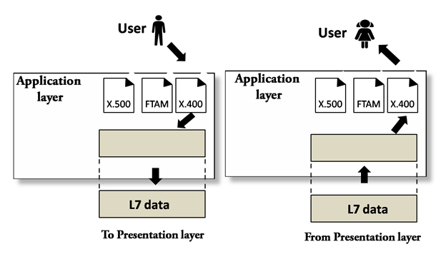
Application Layer
An application layer serves as a window for users and application processes to access network service.
It handles issues such as network transparency, resource allocation, etc.
An application layer is not an application, but it performs the application layer functions.
This layer provides the network services to the end-users.
Functions of Application layer
File transfer, access, and management (FTAM)
Mail services

Slide 52
TCP/IP model

